Slide 1
Abstract Factory Pattern

Slide 2
What Are Design Patterns?
Reusable solutions to a recurring problem
The patterns identified by the Gang of Four general fall into one of 3 categories
Creational – how should objects be created
Structural – how should objects be structured
Behavioural – how should objects interact with one another
Notes:
The patterns represent best practice approaches to solving the problems
Creational patterns:
-creating objects in a flexible and efficient way
-provide mechanism for creating objects while hiding complexities
Structural:
-focus on organising classes into larger structures
-define clear and flexible ways to compose and relate different components
-better able to manage structure of software
Behavioural:
-defining how objects interact
-facilitate effective communication between objects + delegation of responsibilities

Slide 3
What is a Factory?
A means of taking in data and outputting a given object based on rules
Why is this useful?
Separation of concerns
De-coupling of code
Ease of maintenance
When should we use a Factory?
When we don’t know in advance the exact types we will be using with the code
Notes:
Separation of concerns – calling method doesn’t need to know which concrete implementation is required. It just needs to know that it can call a particular behaviour on the output
De-coupling of code – changes to one class shouldn’t need changes to another separate class (open/closed principle)
Ease of maintenance – one place to go to extend behaviour

Slide 4
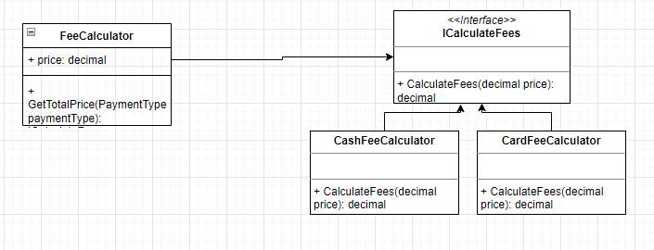
Factory Example
A fee calculator for different kind of payments, e.g. Cash, Card, Google Pay, etc.

Slide 5
Factory Pattern Demo

Slide 6
Abstract Factory Pattern Overview
Commonly referred to as a “Factory of factories”
When should we use Abstract Factory?
When various “families” of related classes are required to be built based on dynamic content
Why is this useful?
Flexibility in creation of concrete objects
Avoids tight coupling
Adherence to SOLID principles

Slide 7
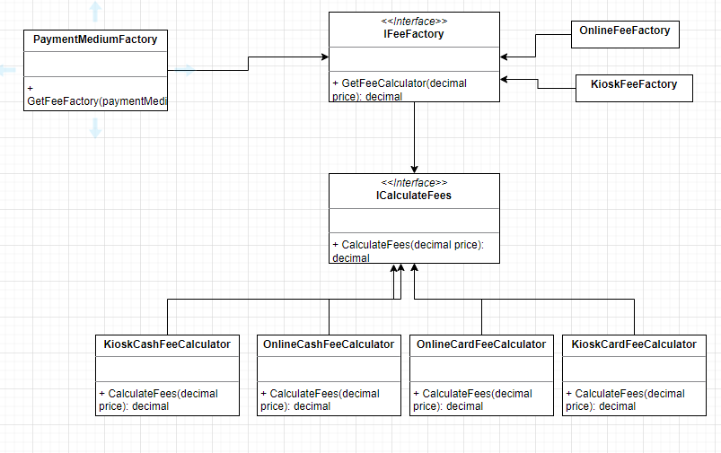
Example Structure

Slide 8
Abstract Factory Pattern Demo

Slide 9
Breakout Time!
You are developing a RPG that involves users creating a character. You’ve decided to implement an abstract factory to facilitate users creating different characters of different races and classes.
The races available are: Human and Elf
The classes available are: Mage, Warrior and Cleric
For simplicity you just need to have the various class/race combinations implement a ToString() for each that print out the Class/Race combination

Slide 10
References
https://www.c-sharpcorner.com/UploadFile/bd5be5/design-patterns-in-net/
https://refactoring.guru/design-patterns/abstract-factory

